Slide 2
ANALOGY
Well basically , what we want to do is to look at flux data of some bodies and try to compute whether the body is an exoplanet or not.
The statement seems to be a mixture of a whole bunch of fancy names so lets break it down.
Basically we can take a simple example, assume you are standing in the middle of the road facing a lamp post with fog in between.
Every some time a bird passes by the lamp post .
Whenever this happens the light come towards us would be reduced all because the bird blocked it.However due to the thick fog the only for us to guess if the thing was a bird is by light fluctuation.
But light also fluctuates due to the movement of fog so we are unsure at times if the fluctuation was due to the bird or the fog movement.
We have been given that around how much light the thing turned out to be a bird ,now we want to train a model which could tell us if at a particular light level the disturbance was due to bird or fog. If u replace the bird with a planet and the lamp with a star we are basically in the regime of space exploration.

Slide 3
THE PROBLEM
When an exoplanets passes in front of a star the amount of flux reduces and hence could be detected in telescopes .
The data set provides us with values of flux (basically the amount of light per unit area) coming from the star and how it varies with time t. Also we are aware that at what particular change the cause would be a exoplanet (planet outside our solar system).
We will use a time varying machine learning model to predict when and when not the body would be an exoplanet.

Slide 4

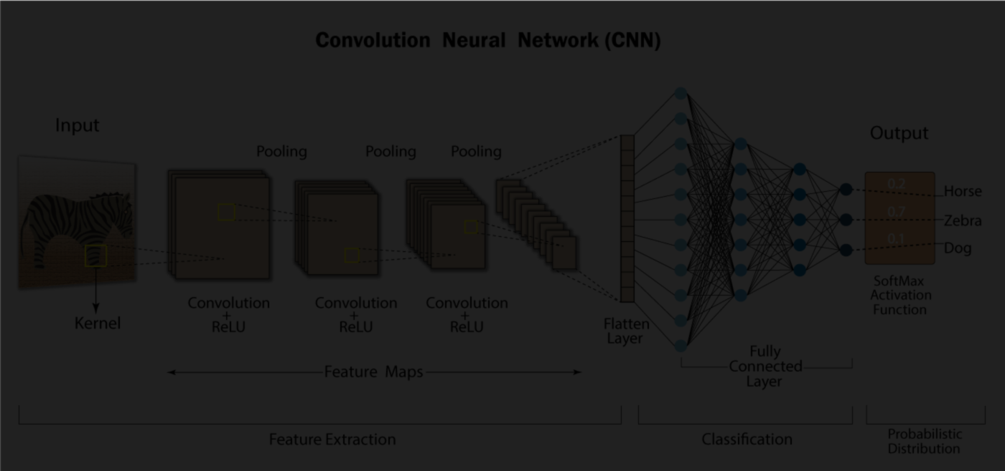
CONVOLUTIONAL NEURAL NETWORKS
Convolutional Neural Networks (CNNs) are a class of deep learning models inspired by the human visual system, designed to automatically and adaptively learn patterns from data. They excel in tasks involving structured grid-like data, making them particularly suitable for image and video analysis.
Convolutional Layers: CNNs use convolutional layers to extract features from input data. These layers apply filters (kernels) to the input, which helps detect low-level features like edges and textures.
Pooling Layers: Pooling layers down sample the feature maps produced by convolutional layers. They help reduce the spatial dimensions of the data while retaining important information, making the network more computationally efficient.
Fully Connected Layers: After several convolutional and pooling layers, CNNs often include one or more fully connected layers for classification or regression tasks. These layers connect all neurons from the previous layer to the current layer

Slide 5
RESULTS AND IMPACTS
Our model had a final test set accuracy of around 95%. The test set had 20% of the dataset.
We expect to see the same or much the same results for newer data as well.

